Slide 1
AUDUBON SOCIETY OF KALAMAZOO
Annual Meeting 5/20/24

Slide 2
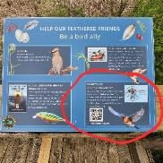
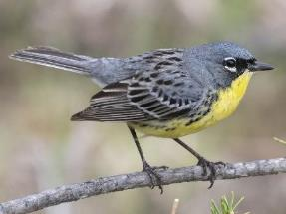
Annual Meeting Agenda – May 20, 2024
Call to Order
Approve Minutes from the 2023 Annual Meeting
Shana Ramsay, Wolf Lake State Fish Hatchery
Beginner Birding Walks - A Success!
ASK Events
Education Programs & Grants
Birdathon Results
Board Election
ASK Needs
Adjourn - let’s go on a bird walk!

Slide 3
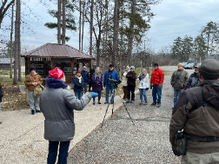
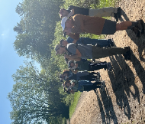
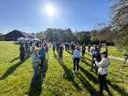
Beginning Birding Walks
Participation has been excellent, with 30-50 attendees each trip, even in the winter. The BBW has been a source of new ASK members, and has also succeeded in attracting some diversity. We have a mix of new and returning attendees.
The pool of volunteer leaders is now up to 10, with others helping out occasionally. Having at least 6 co-leaders at each BBW allows us to break up into smaller, more manageable groups.
Support from the hatchery has been great. They even opened up the Visitor Center in the winter for us, allowing access to restroom facilities. And they’ve helped with extra binoculars to share.
Bird highlights have included Hooded Merganser and many other waterfowl species, Sora, Wilson’s Snipe, Orchard Oriole, Magnolia and other warblers, Purple Finch, and Bald Eagle. A highlight for one of the groups in May was a sighting of two Common Water Snakes.

Slide 4
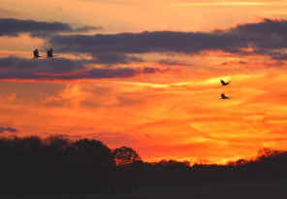
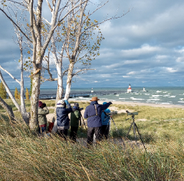
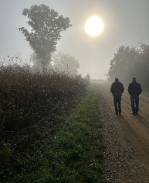
Other Field Trips/Bird Walks
Big thanks to Kent Martin and Sue Creager for organizing and leading 👏🏼👏🏼👏🏼
12 Field Trips!
Locations include Chipman (Butterflies!), Spring Valley Park, Fort Custer SRA, Tiscornia, South County, Gull Lake, Upjohn Park, Muskegon Wastewater, Asylum Lake Preserve, Kleinstuck Preserve, Allegan State Game Area

Slide 5
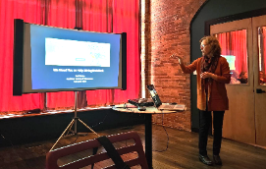
Presentations
“Evolution of a Naturalist: From Lawn Lover to Native Gardener”
Donna Keller presented her talk at the first annual Natural World Symposium and to several other community groups
“Kalamazoo’s Peregrine Falcons”
Gail Walter gave her talk to several community groups
“Window Collisions & Other Hazards / Bird-safe Building Design”
Gail Walter presented to Kellogg Bird Sanctuary, Audubon chapters and community groups
“Birdwatching Basics and Beyond”
Gail Walter and Donna Keller taught a 3-session Osher Lifelong Learning course
“Inviting Birds Into Your Yard”
Joyce Leppard presented to two community groups

Slide 6
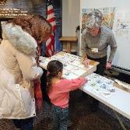
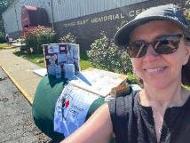
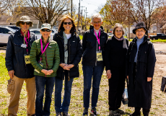
Community Outreach/Tabling Events
ASK participates in numerous community events to educate the attendees
about our organization and “all-things” bird. In 2023-2024, our amazing
volunteers participated in 8 events. Thank you to our Outreach Volunteers!
Kalamazoo Eastside Neighborhood Association Harvest Fest
Cranefest
Birds & Blooms Event
KENA Coffee and Donuts (Seniors and Veterans)
Washington Street Art & Culture Crawl (Edison Neighborhood event)
Natural World Symposium
Wax Wing Brewing Company (Kalamazoo Finest Beer Launch)
Kellogg Bio Station BioBlitz (Volunteers still needed on June 15)

Slide 7
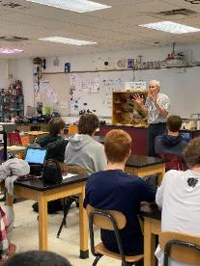
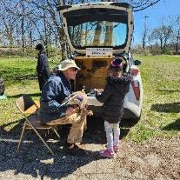
Education Programs
Classroom Visits
Russ Schipper continued to visit elementary classrooms in our community
Woodward School
ASK provided volunteers to support bird-related outdoor education

Slide 8
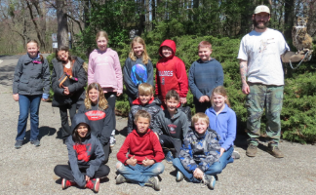
Education Grants
Grants to area schools were made this year in the amount of $9,250!
12th St Elementary - $393.75
Arcadia Elementary - $1000.00
Academically Talented Program (KPS) - $1,000.00
Angling Road Elementary - $300
Northglade Elementary - $1,000.00
Mattawan Middle School - $1,000.00
Mattawan Later Elementary - $500.00
Mattawan Later Elementary - $2,663.80
Mattawan Later Elementary - $593.40
Tobey Elementary - $800.00

Slide 9
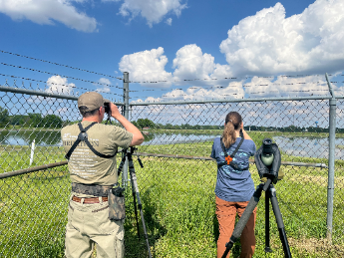
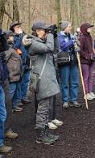
Birdathon
Team: Kent Martin, Joanna Sblendorio,
Donna Keller
Total Species: 116
Total Raised: $2,875
THANK YOU, MEMBERS, FOR YOUR SUPPORT!

Slide 10
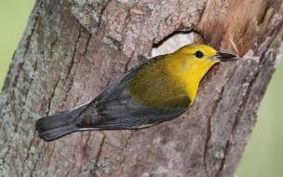
Election of 2024 -2025
Board Members
The following members have agreed to run as Officers and Board members for election at our Annual Meeting, as directed in our By-Laws.
President – Donna Keller Vice President – Gail Walter Secretary – Pam Jackson Treasurer – Nate Strong Board Member- (3rd year of a 3-year term) – Susan Schneider Board Member – (1st year of a 3-year term) – Dave Lemberg Board Member (2nd year of a 3-year term) – Bela Ballez Board Member (1-year term) – Jan Shillito
Photo by Tim Tesar

Slide 11
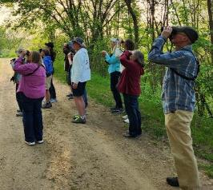
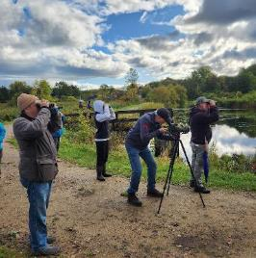
ASK Needs:
Treasurer
Outreach Committee Chair and Committee Members
Diversity, Equity, and Inclusion Committee Members
Peregrine Patrol Volunteers - approximately June 3- June 12

Slide 12
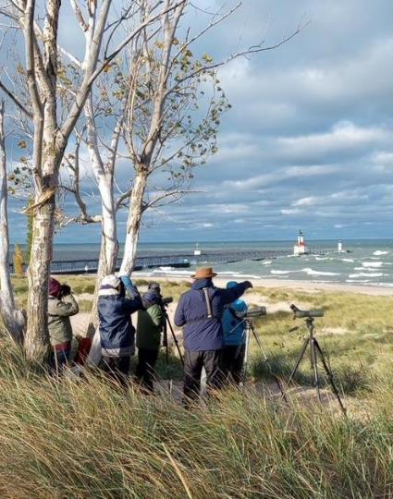
Upcoming Field Trips
Saturday, May 25, 5:00 AM, 8:00 AM, 11:00 AM - Allegan State Game Area Co-leaders: Sue Creager and Kent Martin.
And don’t forget the Weekly Kal-Haven Trail Walks - Tuesday mornings at 9:00 AM through May.
Find out more on the Events page of our website.

Slide 13
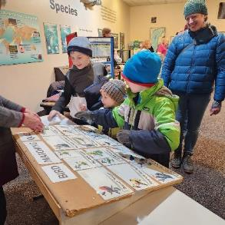
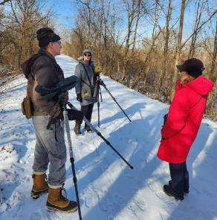
Thank you for attending!

